Slide 1
Timothy Abramov
Electricity Production in Romania (2019-2022)

Slide 2
Dataset
Source: data.world
Daily electricity Consumption and Production in Romania from 2019-2022
Production subdivided by Technology Type
Technology Types:
Hydroelectric
Nuclear
Coal
Oil and Gas
Wind
Solar
Biomass

Slide 3
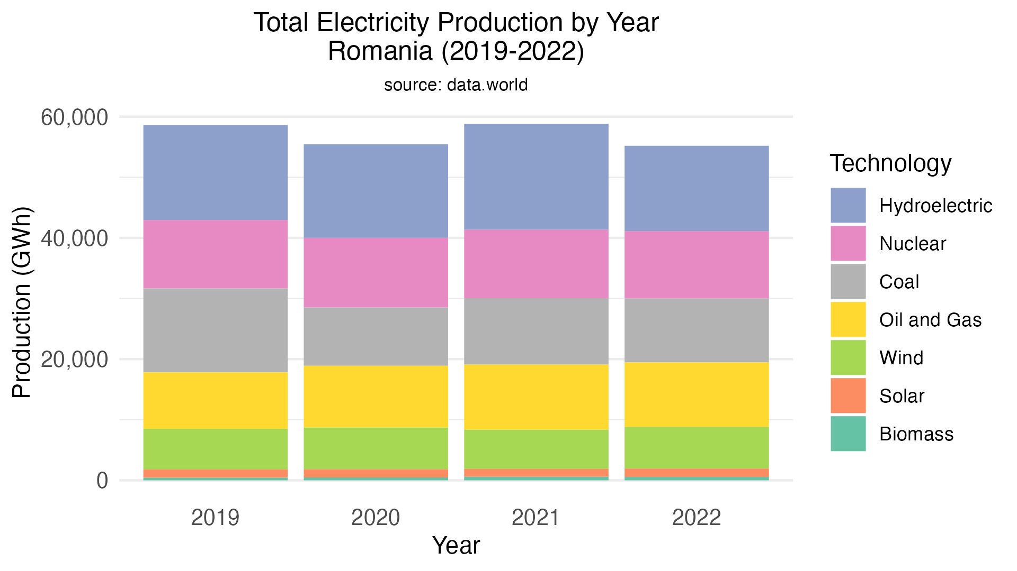

Slide 4
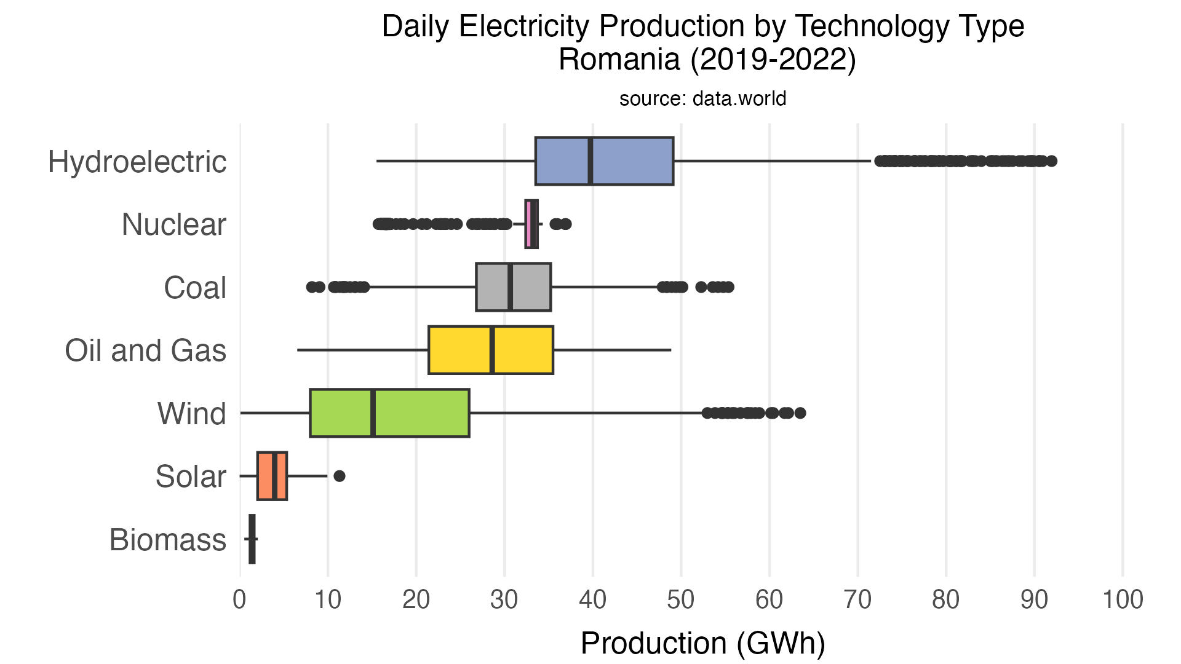

Slide 5
